Slide 1
Digital Image Correlation for 3D-SEM
Development of a scientific analysis method
Department of Applied Physics/ E.T. Faber, J.T. Ouwerling, D. Martinez-Martinez, C. Mansilla-Sanchez, V. Ocelik, J.Th.M. De Hosson

Slide 2
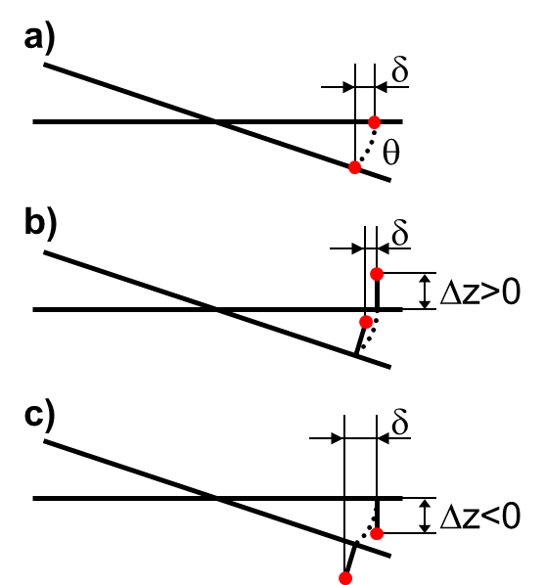
What is 3D-SEM?
Stereoscopic 3D
No information besides images

Slide 3
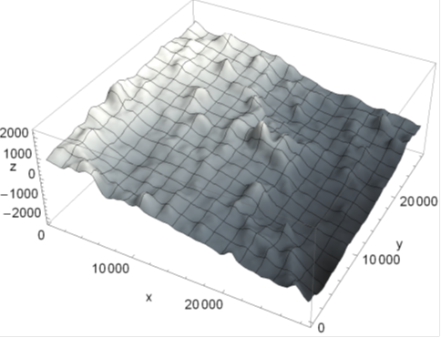

What is 3D-SEM?
Algorithm: 3 2D images → 1 3D image
(nm)
$$F\left(\left\{x_{A},y_{A}\right\}, \left\{x_{B},y_{B}\right\}, \left\{x_{C},y_{C}\right\} \right)$$
Algorithm also calculates orientation and tilting of sample

Slide 4
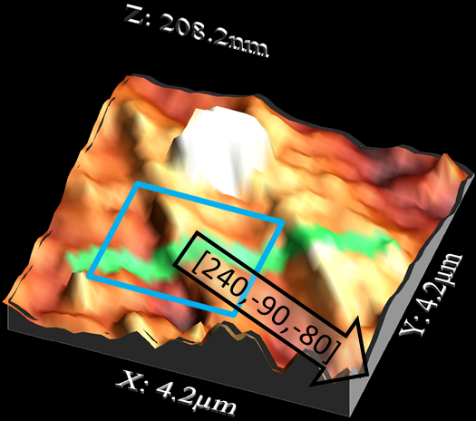
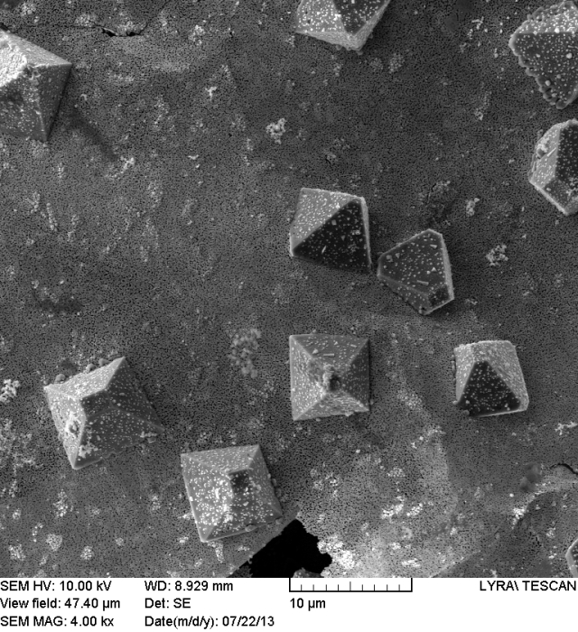
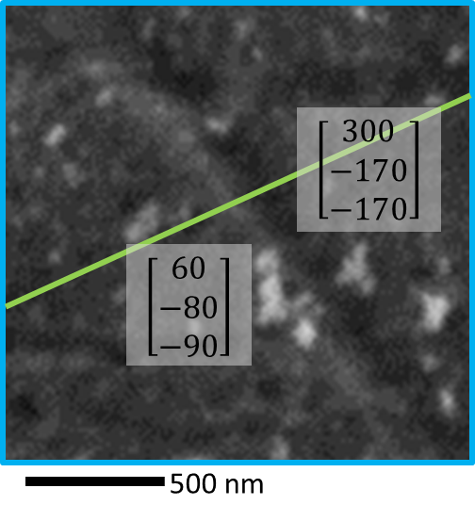
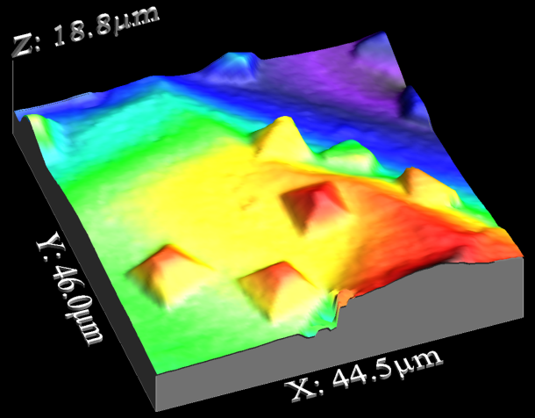
Applications
Steel deformation test
Silver particles on gold
Diatom frustule
(biology; water quality)
Thanks for sample:
Helena Novais
Thanks for sample:
Eric Detsi, Ewout Lubbermans

Slide 5
Development as a scientific research tool
Ease of use
Added value of results
Reliability of results
Scope: check your assumptions when you explore a different research field
Characterization: quantify the accuracy and precision of the result (z)

Slide 6
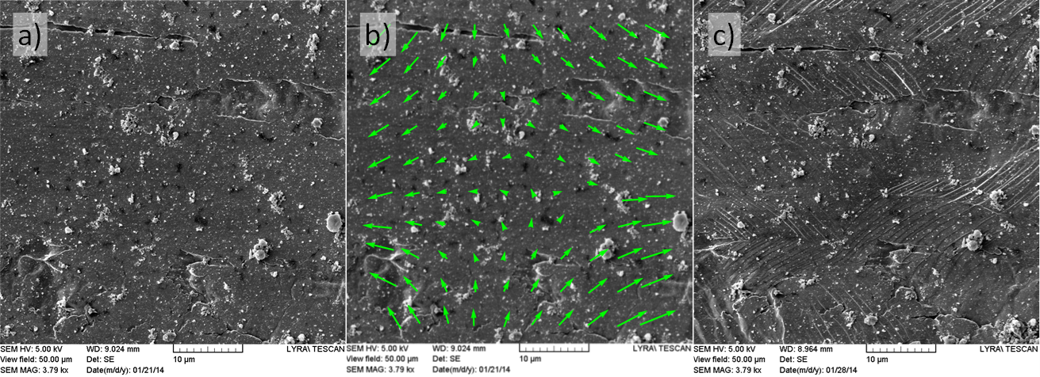
What is Digital Image Correlation (DIC)?
Analysis algorithm which compares (optical) images
Determines 2D (location) and 3D changes

Slide 7
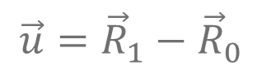
Essentials
$$\vec{u}={\vec{R}}_{1}−{\vec{R}}_{0}$$
Displacement field
Parameter defined to find optimum with
Usually: cross-correlation coefficient
Degrees of freedom, boundary conditions, presence of discontinuities can result in complex algorithm

Slide 8
Joost and Enrico
Essential image correlation algorithm
Build in tools for error quantification
Test with SEM images of surfaces
Well documented so it can be adjusted/improved later
Check assumptions (what are the assumptions in DIC?), characterize results
Continued development

Slide 9
Thank you for your attention

